Slide 1
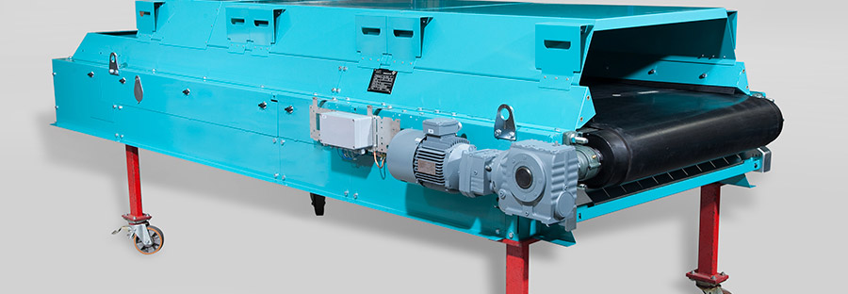
Weigh feeder calibration
SPREAD 2016-2017, Settat May 2016

Slide 2

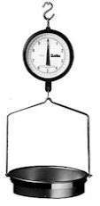
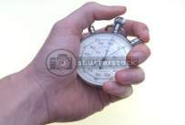
Calibration Methods
  Test Weight method
  Volumetric Measurement
  Loss-in-Weight
  Drop Test (Truck loading)
SPREAD, Settat May 2016, 2017-05-25 © 2016 Company

Slide 3
Calibration: Test Weight Method
SPREAD, Settat May 2016, 2017-05-25 © 2016 Company

Slide 4
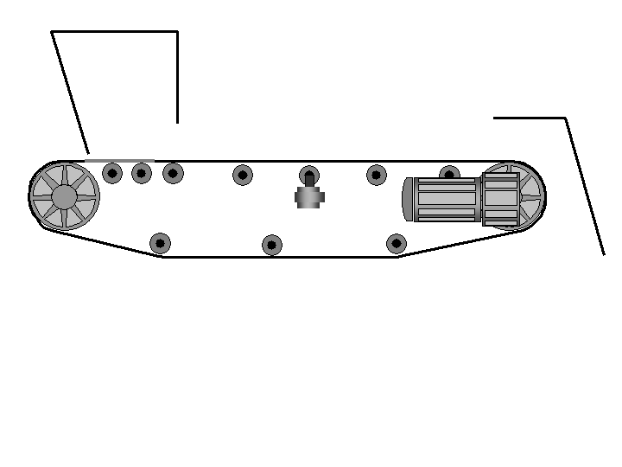
Calibration: Test Weight Method
Zeroing or Taring
0.40 %
ESC
1
2
3
Ent
4
5
6
Span
Zero
Del
7
8
9
>
*
0
#
Running empty weighfeeder
SPREAD, Settat May 2016, 2017-05-25 © 2016 Company

Slide 5
Calibration: Test Weight Method
Zeroing or Taring
0.00 %
ESC
1
2
3
Ent
4
5
6
Span
Zero
Del
7
8
9
>
*
0
#
Running empty weighfeeder
SPREAD, Settat May 2016, 2017-05-25 © 2016 Company

Slide 6
Calibration: Test Weight Method
Span Adjustment
0.00 %
ESC
1
2
3
Ent
4
5
6
Span
Zero
Del
7
8
9
>
*
0
#
Running empty weighfeeder
SPREAD, Settat May 2016, 2017-05-25 © 2016 Company

Slide 7
Calibration: Test Weight Method
Span Adjustment
90.0 %
ESC
1
2
3
Ent
4
5
6
Span
Zero
Del
7
8
9
>
*
0
#
Running empty weighfeeder
Test weight
SPREAD, Settat May 2016, 2017-05-25 © 2016 Company

Slide 8
Calibration: Test Weight Method
Span Adjustment
100.0 %
ESC
1
2
3
Ent
4
5
6
Span
Zero
Del
7
8
9
>
*
0
#
Running empty weighfeeder
Test weight
SPREAD, Settat May 2016, 2017-05-25 © 2016 Company

Slide 9
Calibration: Volumetric Method
SPREAD, Settat May 2016, 2017-05-25 © 2016 Company

Slide 10
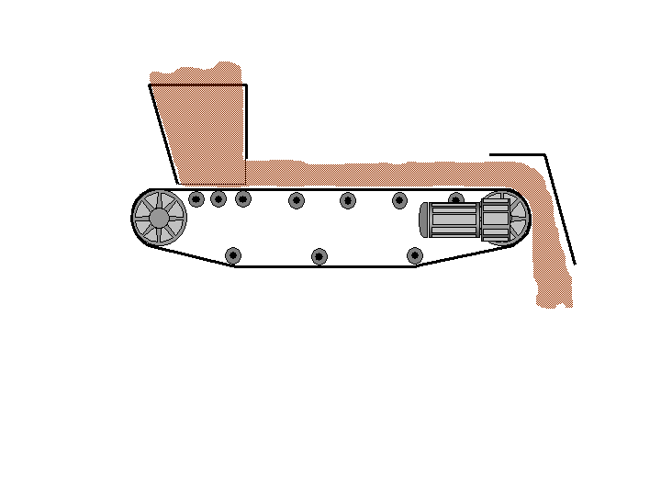
Calibration: Volumetric Method
99.8 T/H
ESC
1
2
3
Ent
4
5
6
Span
Zero
Del
7
8
9
>
*
0
#
Step 1: Record the parameters as indicated in the controller
  Actual feed rate, t/h
  Belt speed or drive speed, m/s
  Weight measured on the platform, kg/m
SPREAD, Settat May 2016, 2017-05-25 © 2016 Company

Slide 11
Calibration: Volumetric Method
Time for one belt circuit
Step 2: Measure the actual belt speed, m/s
    Measure the time to complete one belt circuit, actual length of belt should be known (appropriate for short belts)
    OR
    Measure the speed of the drive pulley, the diameter of the pulley should be known (for long belts)
SPREAD, Settat May 2016, 2017-05-25 © 2016 Company

Slide 12
Calibration: Volumetric Method
Length
Step 3: Weigh the material on the belt (stopped belt)
  Measure the linear weight of the material on a belt section
  Measure the length of the belt section
  The result should be the weight per length, i.e. kg/m
SPREAD, Settat May 2016, 2017-05-25 © 2016 Company

Slide 13
Calibration: Volumetric Method
Length
Step 4: Calculate and compare the feed rate
  Feed rate = Linear weight x Belt speed
  Compare the result with the indicated feed rate
SPREAD, Settat May 2016, 2017-05-25 © 2016 Company

Slide 14
Calibration: Loss-in-Weight Method
SPREAD, Settat May 2016, 2017-05-25 © 2016 Company

Slide 15
Calibration: Loss-in-Weight Method
099.4
ESC
1
2
3
Ent
4
5
6
Del
7
8
9
>
*
0
#
Bin Weight
005.5
ESC
1
2
3
Ent
4
5
6
Del
7
8
9
>
*
0
#
Totaliser
SPREAD, Settat May 2016, 2017-05-25 © 2016 Company

Slide 16
Calibration: Loss-in-Weight Method
Feeding Stopped
_____- ____ =
099.4
ESC
1
2
3
Ent
4
5
6
Del
7
8
9
>
*
0
#
Bin Weight
_____ - _____ =
005.5
ESC
1
2
3
Ent
4
5
6
Del
7
8
9
>
*
0
#
Totaliser
SPREAD, Settat May 2016, 2017-05-25 © 2016 Company

Slide 17
Calibration: Loss-in-Weight Method
Feeding Stopped
____ - ____ =
096.7
ESC
1
2
3
Ent
4
5
6
Del
7
8
9
>
*
0
#
Bin Weight
_____ - ____ =
008.9
ESC
1
2
3
Ent
4
5
6
Del
7
8
9
>
*
0
#
Totaliser
SPREAD, Settat May 2016, 2017-05-25 © 2016 Company

Slide 18
Calibration: Loss-in-Weight Method
____ - ____ =
093.5
ESC
1
2
3
Ent
4
5
6
Del
7
8
9
>
*
0
#
Bin Weight
_____ - ____ =
011.6
ESC
1
2
3
Ent
4
5
6
Del
7
8
9
>
*
0
#
Totaliser
SPREAD, Settat May 2016, 2017-05-25 © 2016 Company

Slide 19
Calibration: Loss-in-Weight Method
____ - ____ =
090.3
ESC
1
2
3
Ent
4
5
6
Del
7
8
9
>
*
0
#
Bin Weight
_____ - ____ =
014.1
ESC
1
2
3
Ent
4
5
6
Del
7
8
9
>
*
0
#
Totaliser
SPREAD, Settat May 2016, 2017-05-25 © 2016 Company

Slide 20
Calibration: Loss-in-Weight Method
____ - ____ =
087.4
ESC
1
2
3
Ent
4
5
6
Del
7
8
9
>
*
0
#
Bin Weight
_____ - ____ =
017.4
ESC
1
2
3
Ent
4
5
6
Del
7
8
9
>
*
0
#
Totaliser
SPREAD, Settat May 2016, 2017-05-25 © 2016 Company

Slide 21
Calibration: Loss-in-Weight Method
Feeding Empty
Record Initial Weight
84.6 - ____ =
084.6
ESC
1
2
3
Ent
4
5
6
Del
7
8
9
>
*
0
#
Bin Weight
Record Initial Reading
_____ - 20.7 =
020.7
ESC
1
2
3
Ent
4
5
6
Del
7
8
9
>
*
0
#
Totaliser
SPREAD, Settat May 2016, 2017-05-25 © 2016 Company

Slide 22
Calibration: Loss-in-Weight Method
Feeding Empty
Record Initial Weight
84.6 - ____ =
081.8
ESC
1
2
3
Ent
4
5
6
Del
7
8
9
>
*
0
#
Bin Weight
Record Initial Reading
_____ - 20.7 =
023.5
ESC
1
2
3
Ent
4
5
6
Del
7
8
9
>
*
0
#
Totaliser
SPREAD, Settat May 2016, 2017-05-25 © 2016 Company

Slide 23
Calibration: Loss-in-Weight Method
Bin Discharging
84.6 - ____ =
079.2
ESC
1
2
3
Ent
4
5
6
Del
7
8
9
>
*
0
#
Bin Weight
_____ - 20.7 =
026.1
ESC
1
2
3
Ent
4
5
6
Del
7
8
9
>
*
0
#
Totaliser
SPREAD, Settat May 2016, 2017-05-25 © 2016 Company

Slide 24
Calibration: Loss-in-Weight Method
Bin Discharging
84.6 - ____ =
076.3
ESC
1
2
3
Ent
4
5
6
Del
7
8
9
>
*
0
#
Bin Weight
_____ - 20.7 =
029.3
ESC
1
2
3
Ent
4
5
6
Del
7
8
9
>
*
0
#
Totaliser
SPREAD, Settat May 2016, 2017-05-25 © 2016 Company

Slide 25
Calibration: Loss-in-Weight Method
84.6 - ____ =
073.7
ESC
1
2
3
Ent
4
5
6
Del
7
8
9
>
*
0
#
Bin Weight
_____ - 20.7 =
031.4
ESC
1
2
3
Ent
4
5
6
Del
7
8
9
>
*
0
#
Totaliser
SPREAD, Settat May 2016, 2017-05-25 © 2016 Company

Slide 26
Calibration: Loss-in-Weight Method
84.6 - ____ =
070.5
ESC
1
2
3
Ent
4
5
6
Del
7
8
9
>
*
0
#
Bin Weight
_____ - 20.7 =
034.6
ESC
1
2
3
Ent
4
5
6
Del
7
8
9
>
*
0
#
Totaliser
SPREAD, Settat May 2016, 2017-05-25 © 2016 Company

Slide 27
Calibration: Loss-in-Weight Method
84.6 - ____ =
067.8
ESC
1
2
3
Ent
4
5
6
Del
7
8
9
>
*
0
#
Bin Weight
_____ - 20.7 =
037.6
ESC
1
2
3
Ent
4
5
6
Del
7
8
9
>
*
0
#
Totaliser
SPREAD, Settat May 2016, 2017-05-25 © 2016 Company

Slide 28
Calibration: Loss-in-Weight Method
Bin near critical level
84.6 - ____ =
064.4
ESC
1
2
3
Ent
4
5
6
Del
7
8
9
>
*
0
#
Bin Weight
_____ - 20.7 =
040.5
ESC
1
2
3
Ent
4
5
6
Del
7
8
9
>
*
0
#
Totaliser
SPREAD, Settat May 2016, 2017-05-25 © 2016 Company

Slide 29
Calibration: Loss-in-Weight Method
Process Complete
Record Final Weight
84.6 - 61.1=
061.1
ESC
1
2
3
Ent
4
5
6
Del
7
8
9
>
*
0
#
Bin Weight
Record Final Reading
43.4 - 20.7 =
043.4
ESC
1
2
3
Ent
4
5
6
Del
7
8
9
>
*
0
#
Click for Next Page
Totaliser
SPREAD, Settat May 2016, 2017-05-25 © 2016 Company

Slide 30
Calibration: Loss-in-Weight Method
Process Complete
Calculate Net
84.6 - 61.1= 23.5 T
061.1
ESC
1
2
3
Ent
4
5
6
Del
7
8
9
>
*
0
#
Bin Weight
Calculate Net
43.4 - 20.7 = 22.7 T
043.4
ESC
1
2
3
Ent
4
5
6
Del
7
8
9
>
*
0
#
Totaliser
The difference will be considered on the span value
SPREAD, Settat May 2016, 2017-05-25 © 2016 Company

Slide 31
Calibration: Drop Test Method
SPREAD, Settat May 2016, 2017-05-25 © 2016 Company

Slide 32
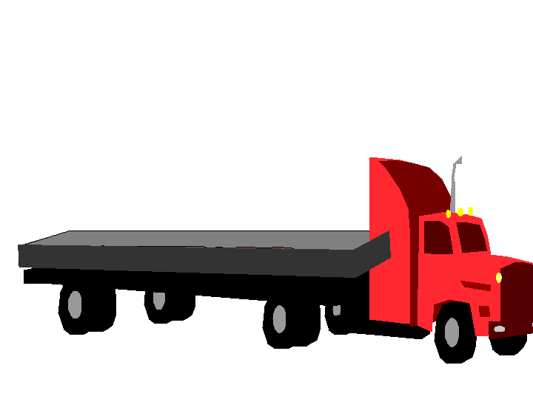
Calibration: Drop Test Method
061.1
ESC
1
2
3
Ent
4
5
6
Del
7
8
9
>
*
0
#
Totaliser
043.4
ESC
1
2
3
Ent
4
5
6
Del
7
8
9
>
*
0
#
Truck Scale
SPREAD, Settat May 2016, 2017-05-25 © 2016 Company

Slide 33

Summary
SPREAD, Settat May 2016, 2017-05-25 © 2016 Company

